Slide 1
Office 365 Development

Slide 2
Course Agenda
Introduction to Office 365 Development
Module 1: Overview of Office 365 Development
Module 2: Getting started with Apps for Office
Module 3: Getting started with Apps for SharePoint
Module 4: Getting started with the Office 365 APIs
Module 5: Getting started with Mobile development with Office 365
Module 6: Moving Full Trust Code to the Cloud Using Repeatable Patterns and Best Practices
Module 7: Setting up your Developer environment in Office 365
Module 8: Setting up your on-premises environment for app development

Slide 3
Getting started with the Office 365 APIs

Slide 4

Agenda
Intro to the Office 365 APIs
Getting started
Demos

Slide 5
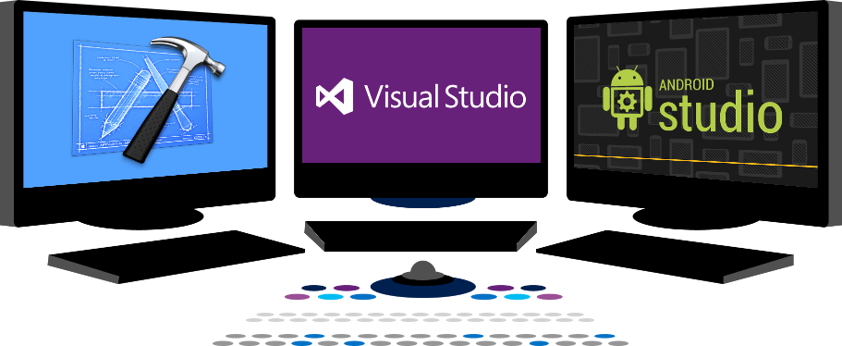














Vision
EXTEND OFFICE EVERYWHERE
CONNECT TO OFFICE 365 SERVICES
BUILD USING AN OPEN PLATFORM
Delve
z
Users and groups
Files
Mail
Calendar
My Apps
Video Portal
Contacts
Office Graph
Presentations
Documents
Spreadsheets
Lync
OneNote
Yammer

Slide 6
Intro to the Office 365 APIs

Slide 7
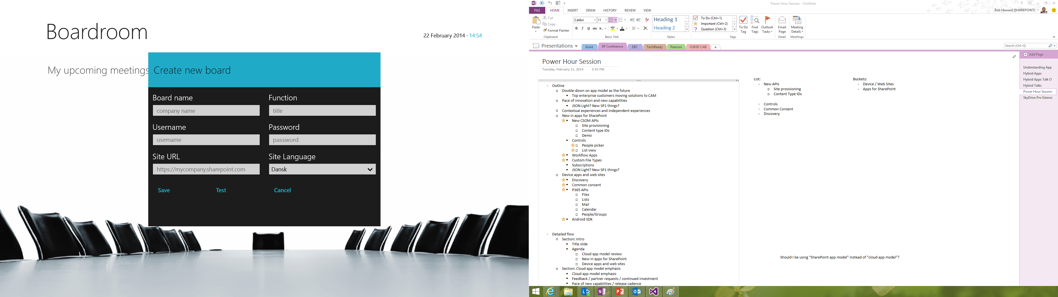
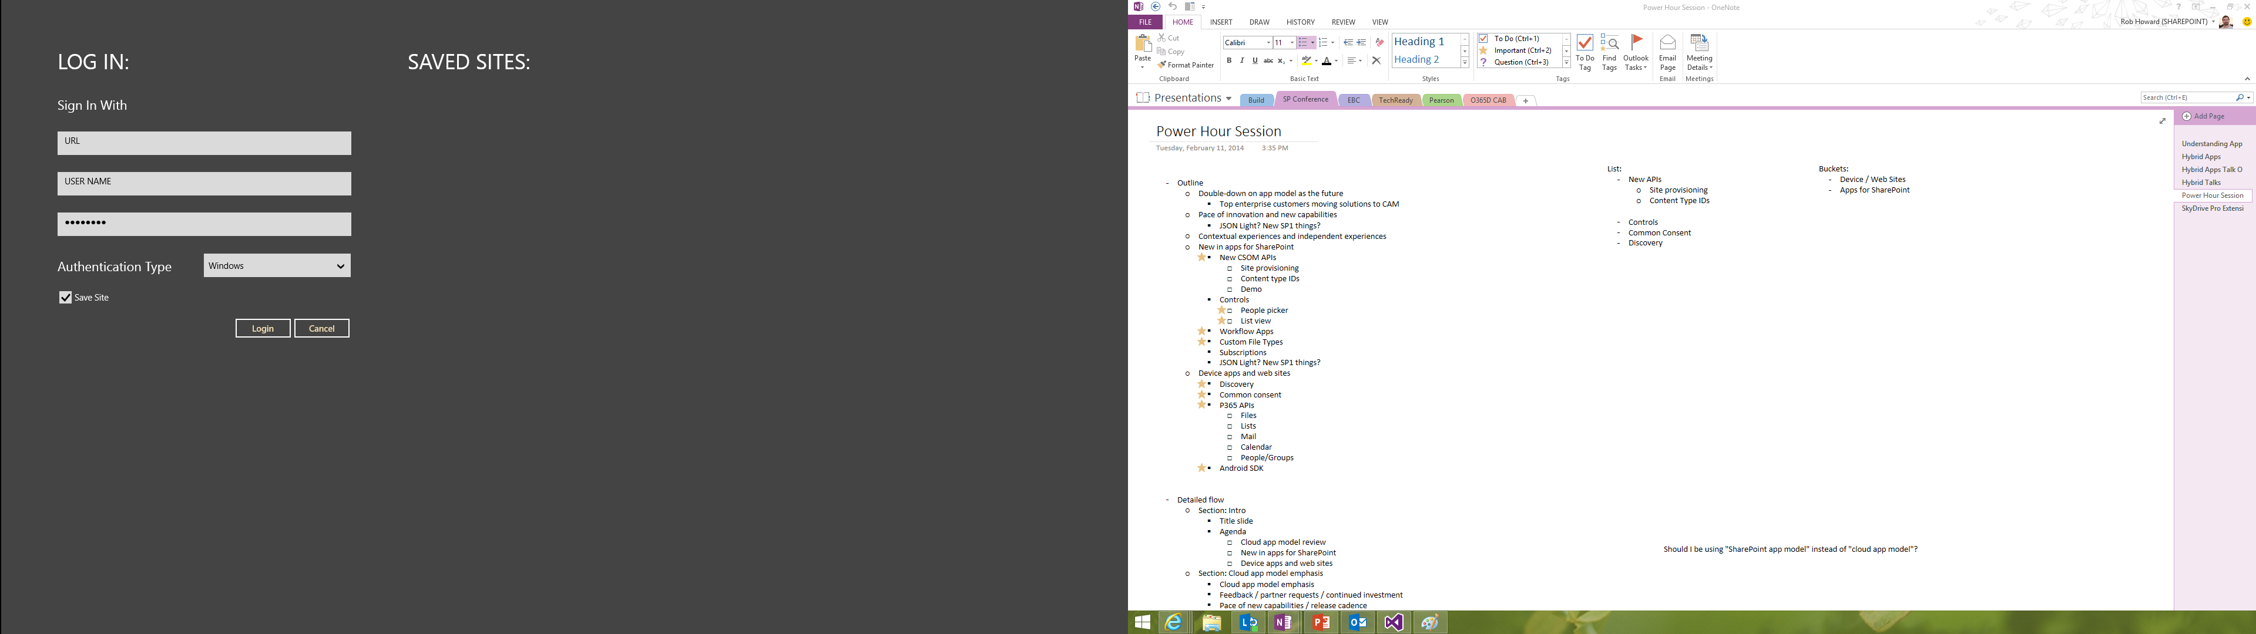
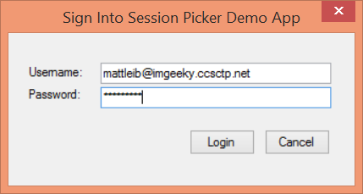
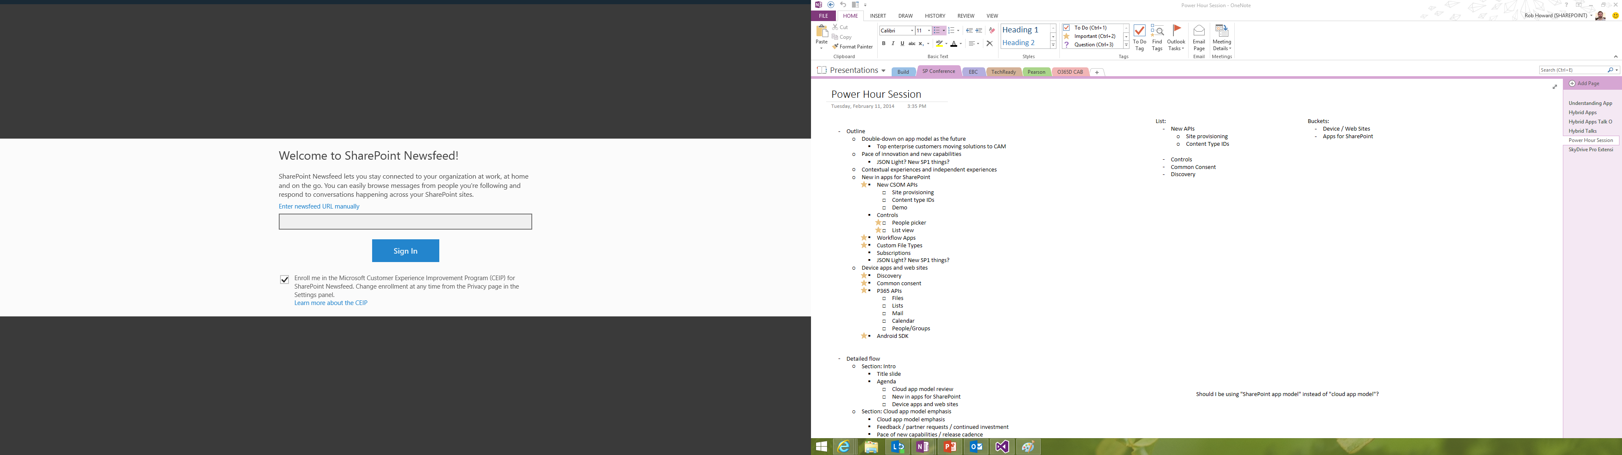
Office 365 device apps

Slide 8
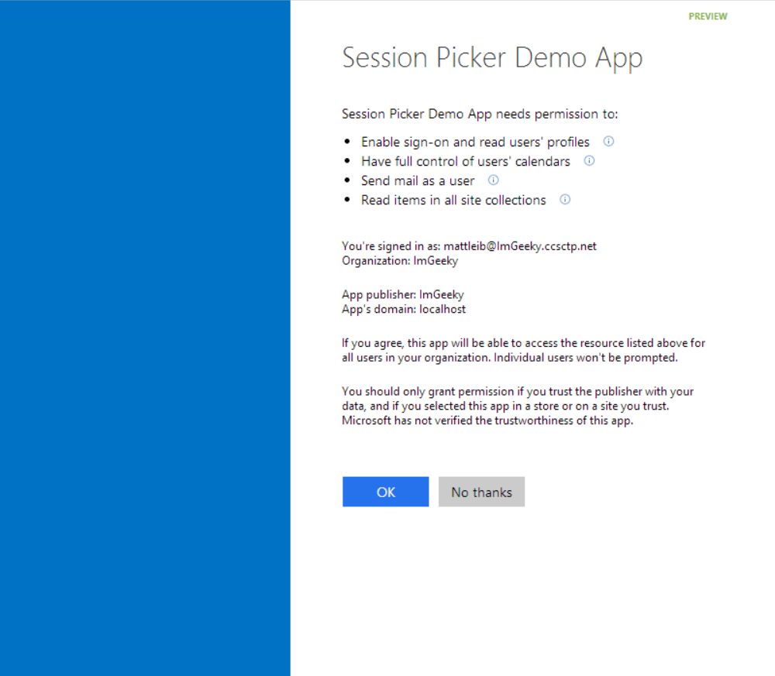
Common consent

Slide 9
Single authentication flow for Office 365
Azure AD graph, Exchange, SharePoint,…
Device apps and standalone websites
Admin and end-user consent

Slide 10
Secure protocol
OAuth 2.0
No capturing user credentials
Fine-grained access scopes
Supports MFA and federated user sign-in
Long-term access through refresh tokens

Slide 11
Office 365 discovery services
Automatically determine URL of O365 services
Supports device app and website flows
Secured using Azure AD authentication
Serves information stored about services in AAD

Slide 12
The SharePoint client APIs
Sites, Lists and Libs
Workflow
Search
Taxonomy
BCS
…
_api
Execute query
REST/ OData
JavaScript library
Silverlight library
.Net CLR library
Custom client code

Slide 13
Office 365 APIs Roadmap
Active Directory
Exchange & Outlook.com
SharePoint
OneDrive
Sites
OneDrive
Users
Mail
Calendar
Client API
OneDrive for Business
Sites, Lists and Libs
Taxonomy
Groups
Contacts
Workflow
BCS
Search
…

Slide 14
Getting Started

Slide 15
http://aka.ms/o365apis

Slide 16
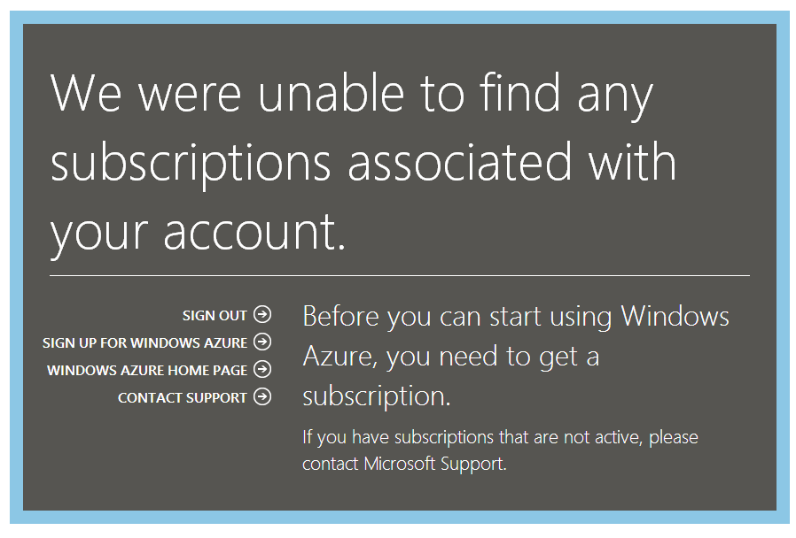

Slide 17
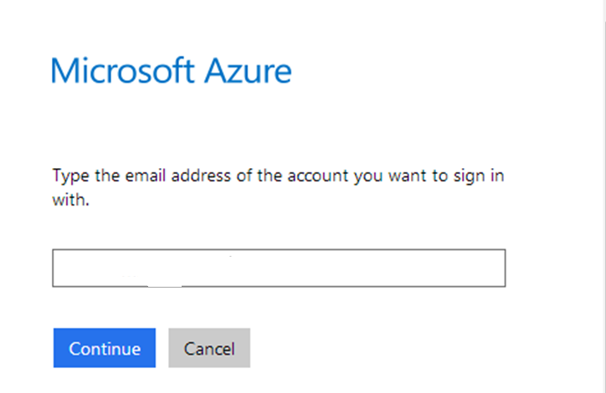

Slide 18
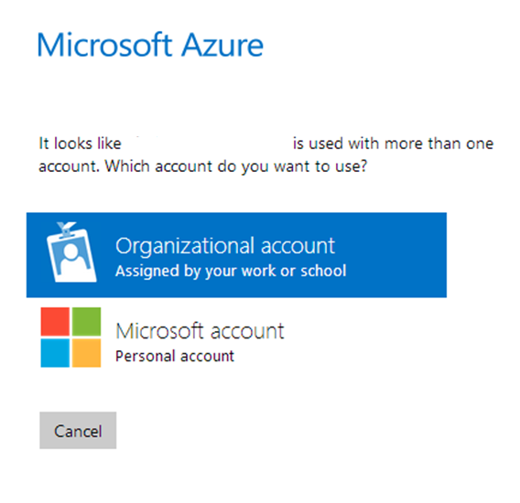

Slide 19
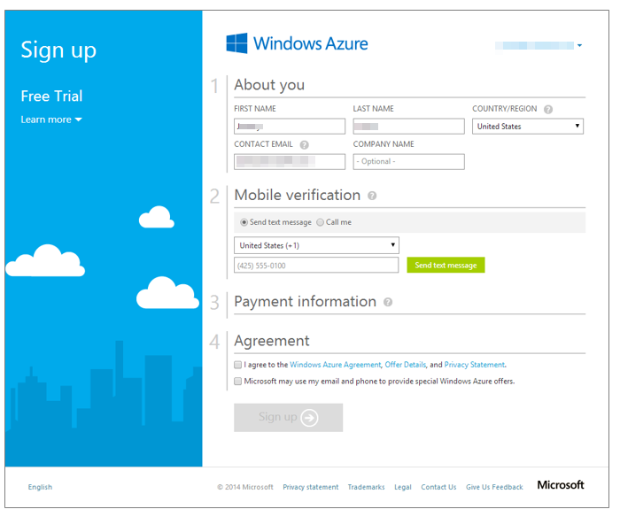

Slide 20
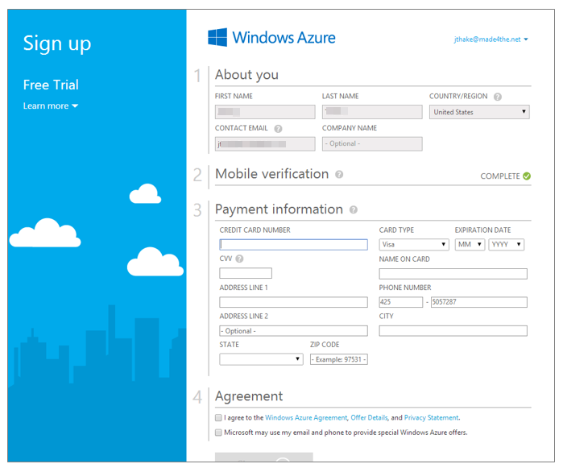

Slide 21
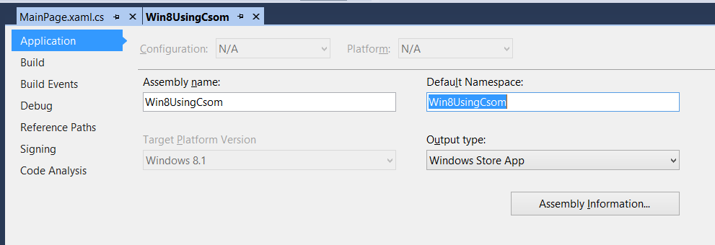

Slide 22
demo
Azure Active Directory portal

Slide 23
demo
Authentication process
Notes:
Use demo sample from MSDN Code Gallery http://code.msdn.microsoft.com/Office-365-APIs-How-to-use-609102ea

Slide 24
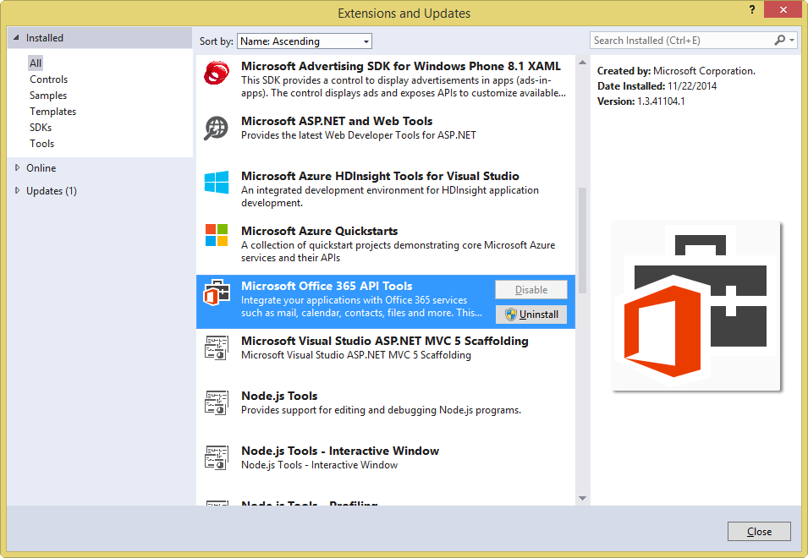
Get the tools

Slide 25
Visual Studio project support
.NET Windows Store Apps
Windows Forms Application
WPF Application
ASP.NET MVC Web Application
ASP.NET Web Forms Application
Xamarin Android and iOS Applications
Multi-device Hybrid Apps (Cordova)

Slide 26
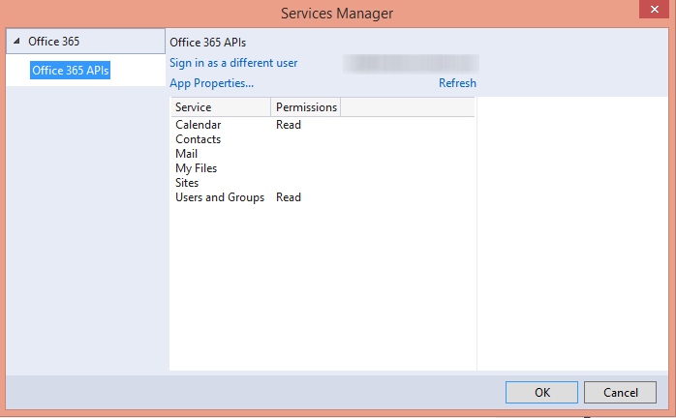

Slide 27
demo
Getting started Office 365 API tools for VS ASP.NET MVC

Slide 28
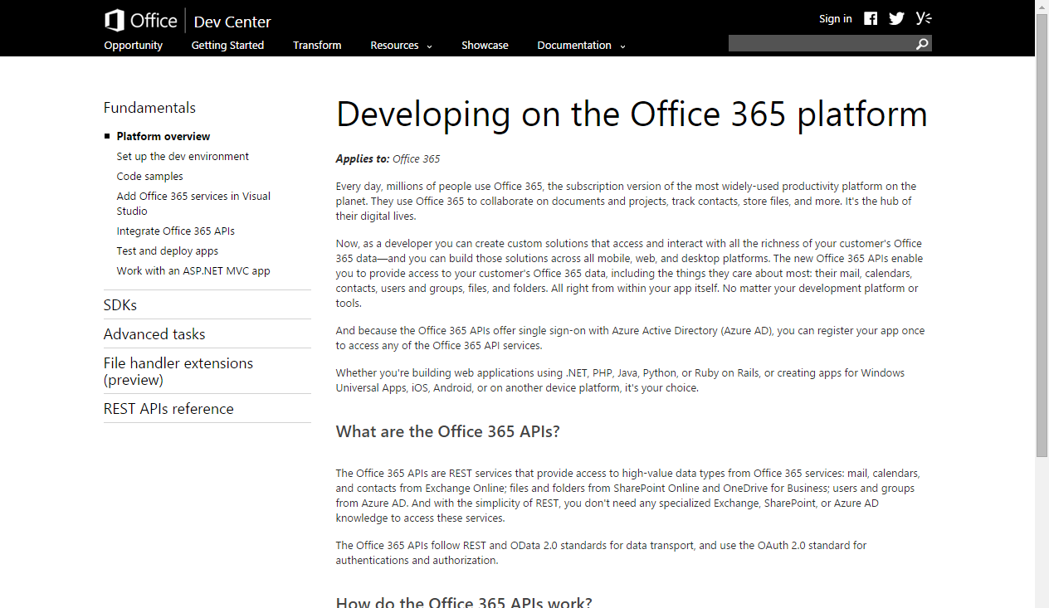
http://aka.ms/Office365DevAPIs

Slide 29
Demos

Slide 30
demo
ASP.NET MVC project demo
Notes:
SharePoint Power Hour O365aPI Full Stack demo https://github.com/OfficeDev/SharePoint-Power-Hour-Code-Samples/tree/master/O365ApiFullStack

Slide 31
demo
AngularJS HTML/JS project demo
Notes:
Research Project

Slide 32
Summary
Intro to the Office 365 APIs
Getting started
Demos

Slide 33



dev.office.com
Sign up
http://dev.office.com/getting-started
Explore
http://apisandbox.msdn.microsoft.com
Get trained http://dev.office.com/training

Slide 34


Feedback
Office 365 Network Share you best practices and join conversations https://www.yammer.com/itpronetwork
Stackoverflow Ask deep technical questions to a world-wide set of developers
http://stackoverflow.com/questions/tagged/ms-office
UserVoice Provide suggestions of what you want in future versions
http://officespdev.uservoice.com/

